Slide 1
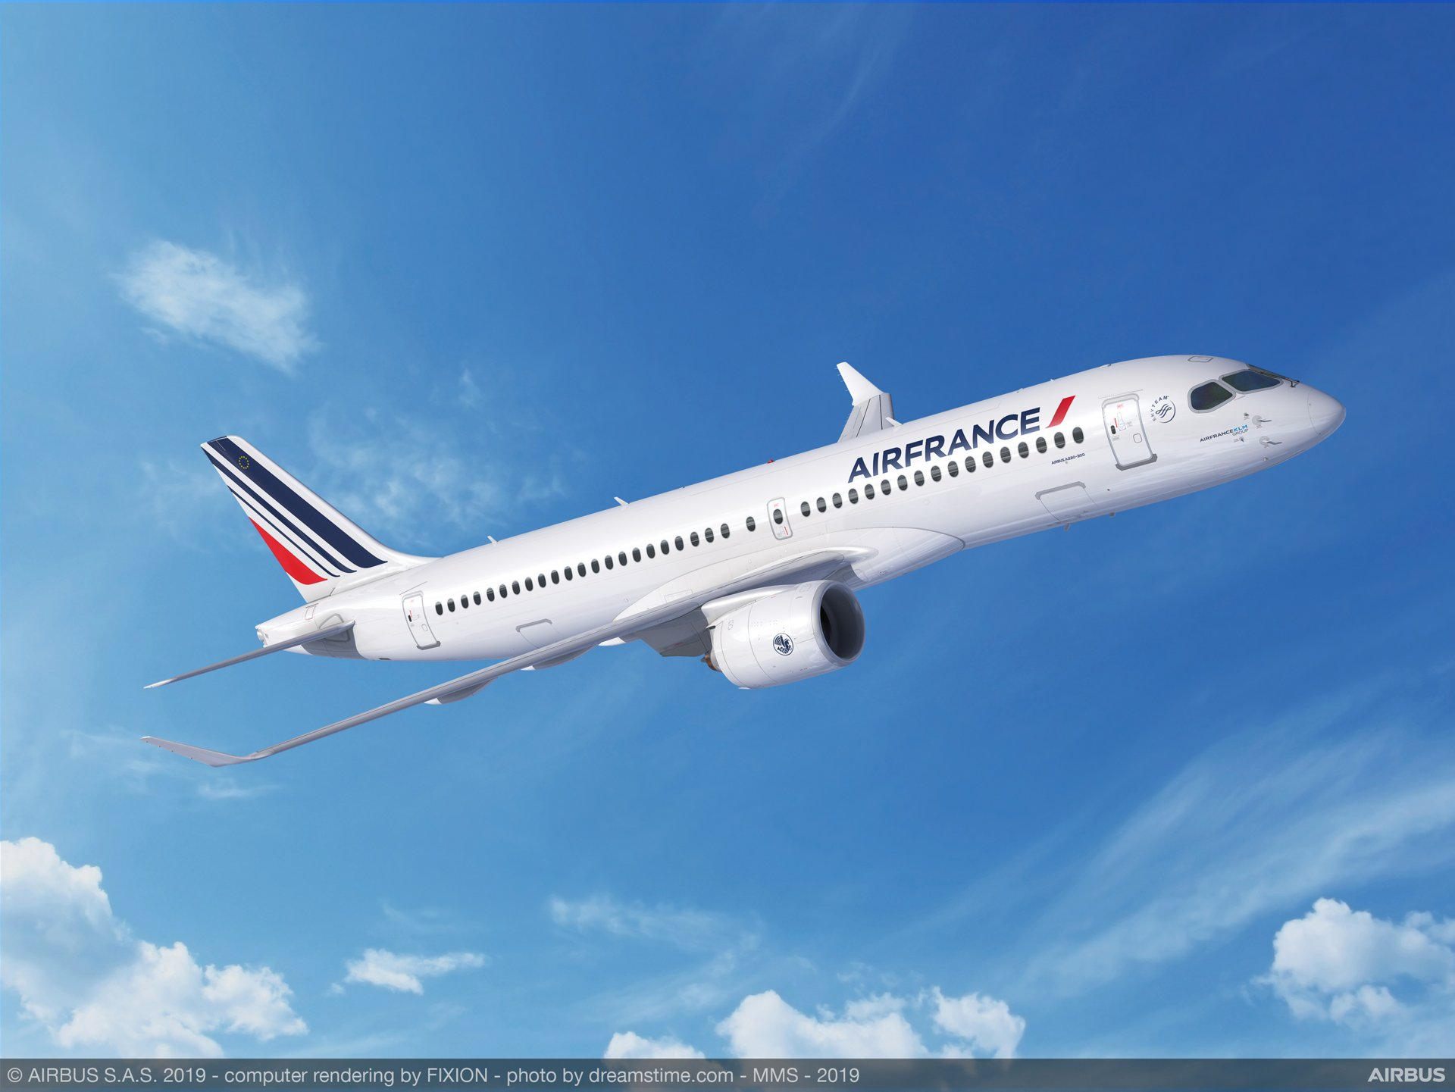
Team 8
Air France
Presentation
Ela Yenikoylu | Noe Urbina Salazar
Shaiffali Sagar | Sharon French |
Jinsoo Whang Lee

Slide 2


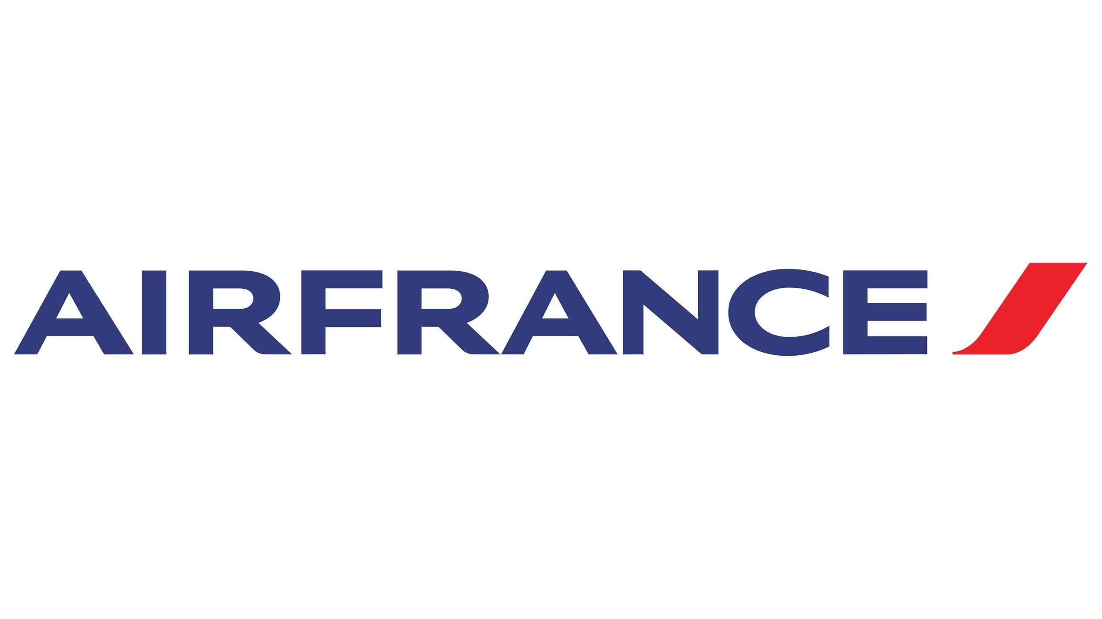
Introduction
Goal: To give insights on web-marketing strategy and provide recommendations to AF marketing team that will improve marketing strategy to bring more revenue to the company.

Slide 3
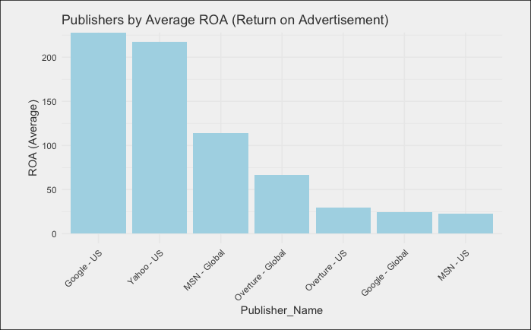
Yahoo US : One of the top Average ROA

Slide 4

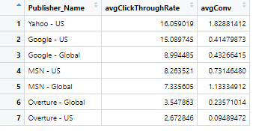
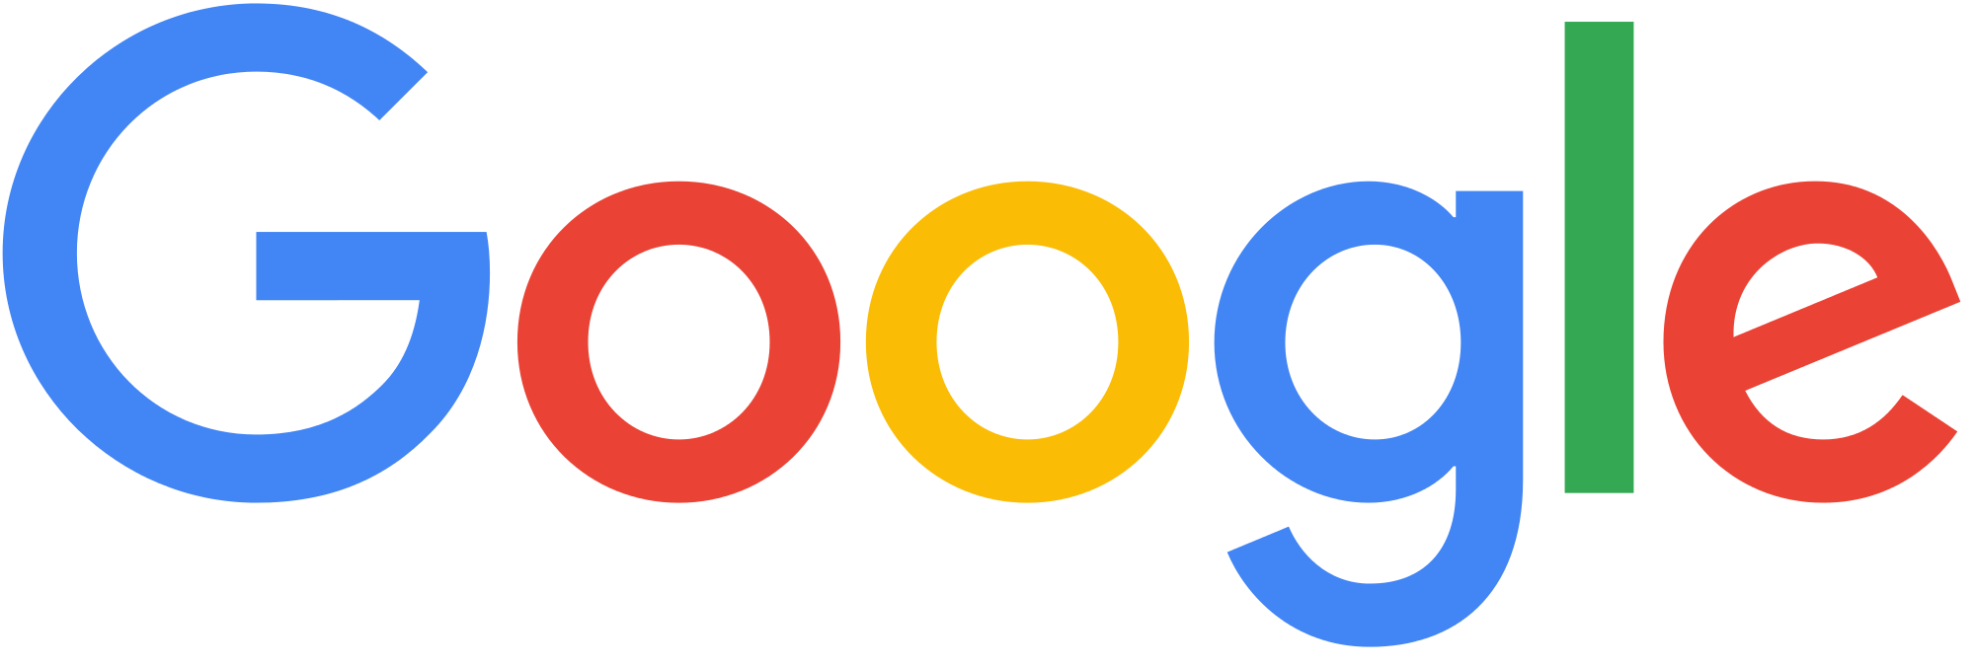
Yahoo US: Best in 2 important categories

Slide 5
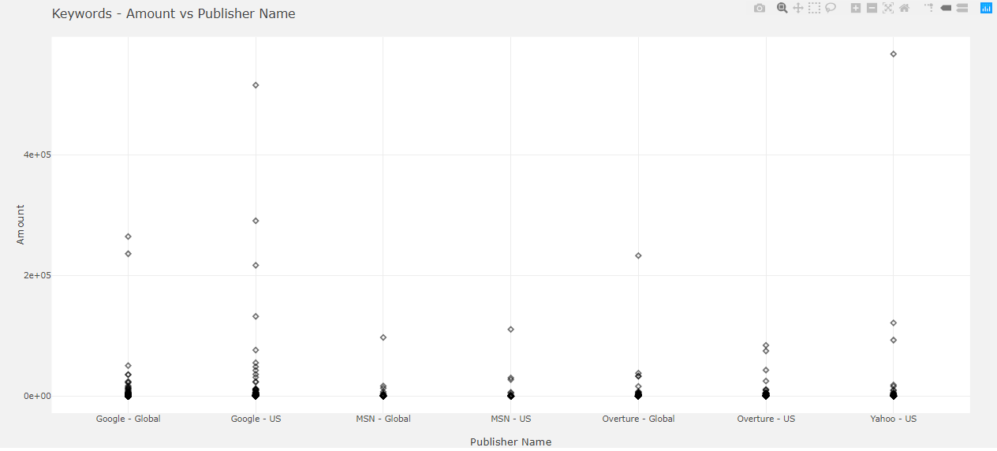
Yahoo US - Highest Amount earned from an exact keyword search

Slide 6


Slide 7
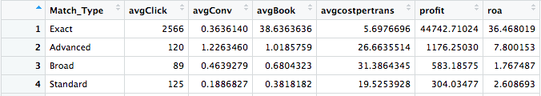
Keyword Match Type - Broad
Broad has the highest click-through rate
Broad has the highest average cost per transaction
6 times the average cost per transaction of exact
Notes:
Since exact match type has a higher average click through rate compared to all other match types Air France should focus majority of its efforts on exact keywords rather than broad.

Slide 8
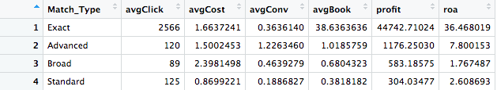
Keyword Match Type - Exact
Exact is 21 times better ROA than broad
Average cost per click being the 4th lowest
Second best in conversion rate by match type

Slide 9
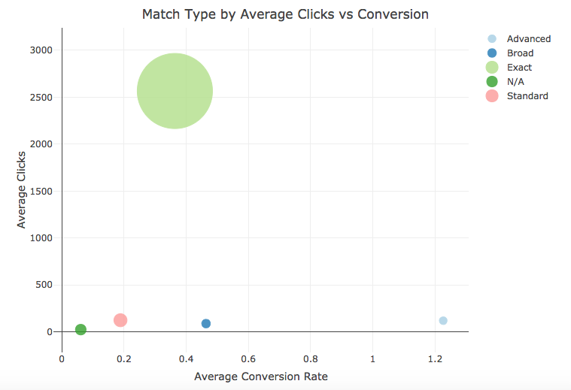
Match Type: Click Through vs Conversion Rate
Exact match type has a higher average click through rate compared to all other match types

Slide 10
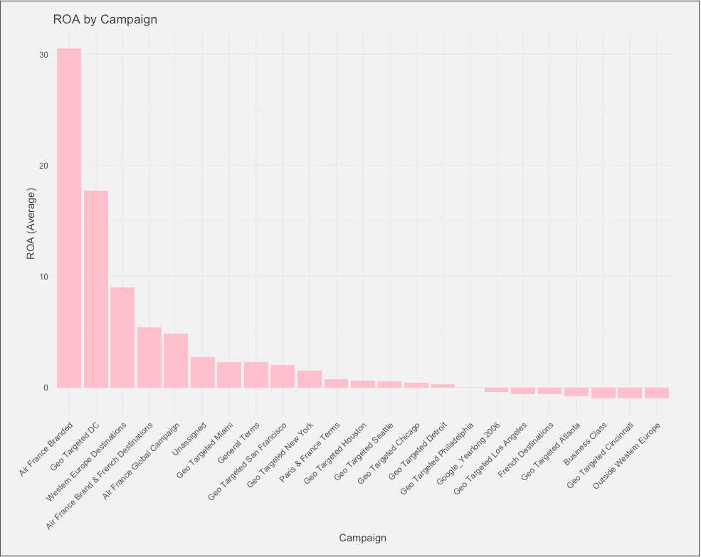
Campaign ROA
Air France branded performs is the best performing campaign with the highest ROA.
All ROA less than 1 must be dropped to utilize funds in better performing campaigns.

Slide 11
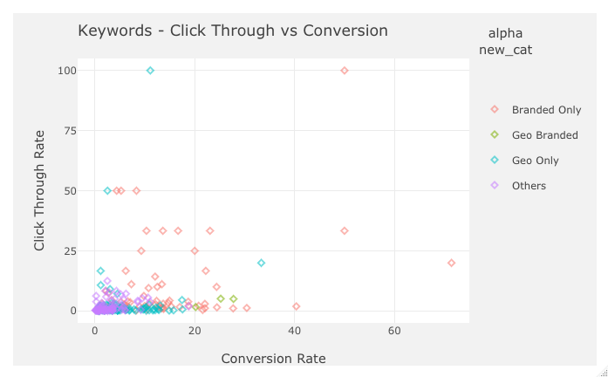
Keyword Performance
http://18.220.2.166/connect/#/apps/357/access

Slide 12
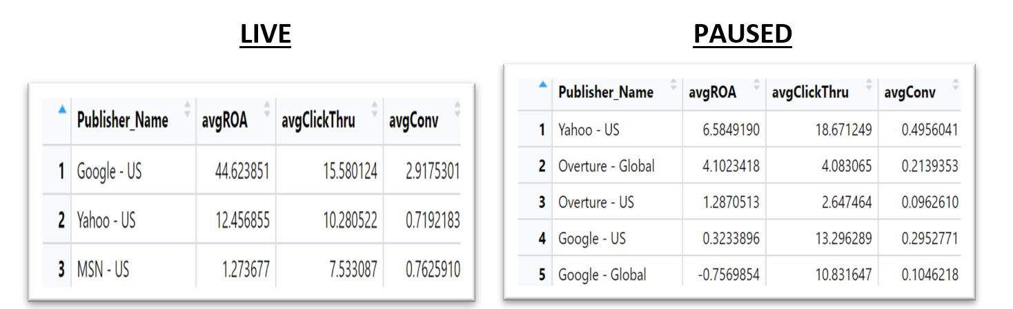
Status: Live vs Paused
This is where the image or writing should be in

Slide 13
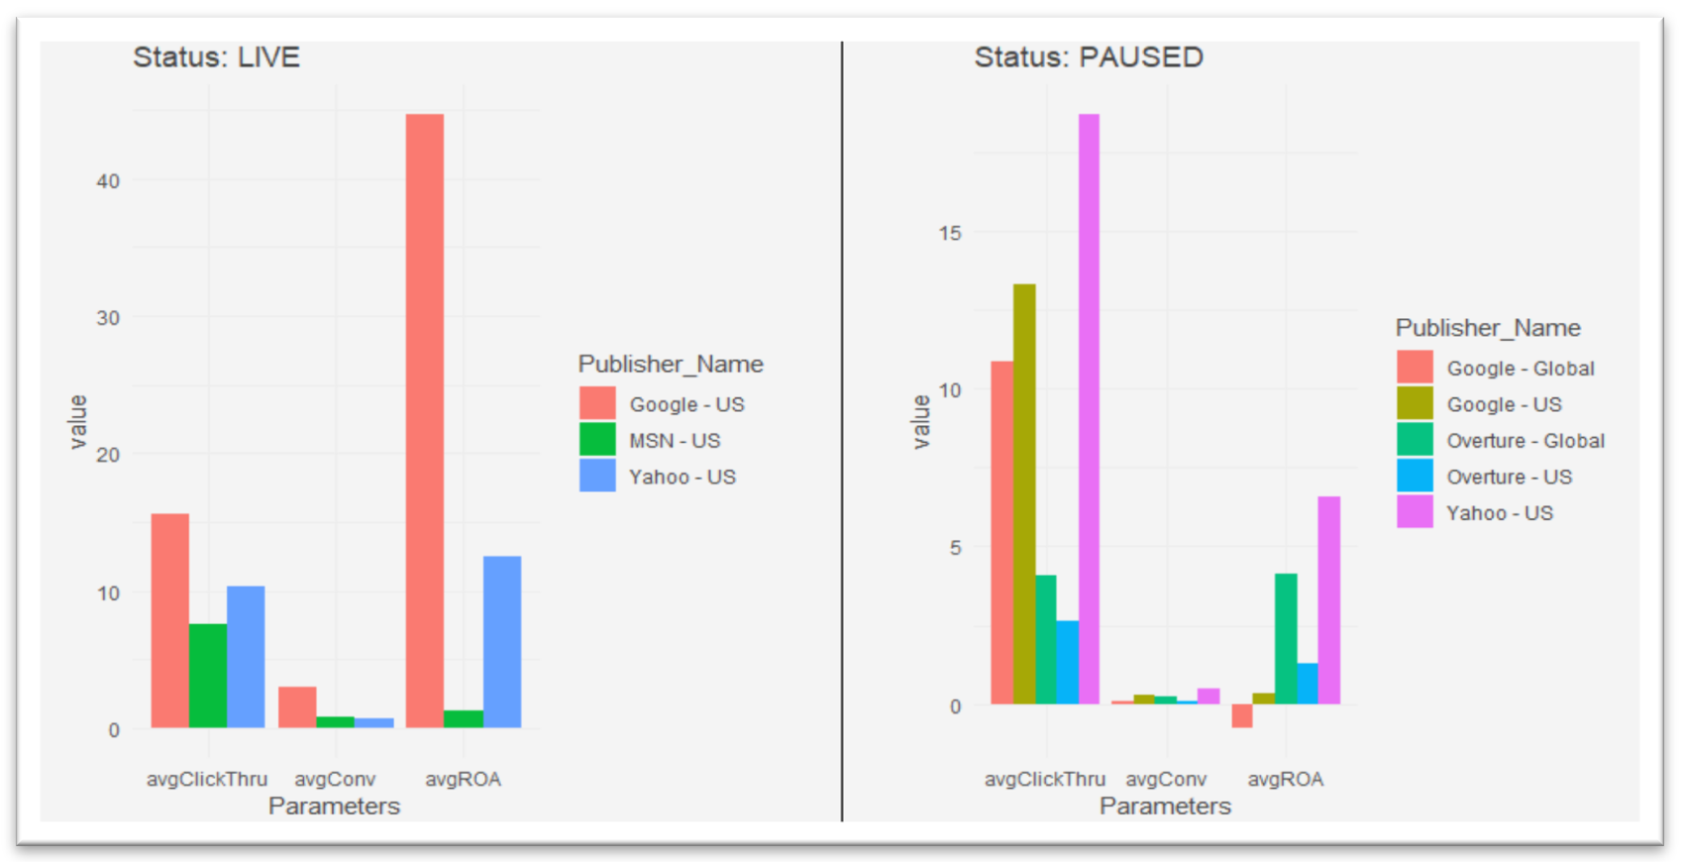
Status: Live vs Paused

Slide 14
Conclusion
Since exact match type has a higher average Click Through Rate compared to all other match types, Air France should focus the majority of its efforts on exact keywords rather than broad.
Air France branded is the best performing campaign with the highest ROA. All ROA less than 1 must be dropped to utilize funds in better performing campaigns.
As we compared the statuses of campaign, average click through rate and average conversion rate of Air France, we recommend the company to outstretch its investments in Yahoo-US; it can bring in potentially better ROA along with Google-US to be on the top of the Airline industry.

